Slide 1

EV Charging Infrastructure: Market Entry Opportunity in India
Business Problem:
“A company wants to enter Indian market for the development of EV Charging Infrastructure. He wants the analysis of the market, revenue, costs, profit and break-even areas.”
To solve this we need to analyze:
How big is the Market Opportunity?
How much Revenue and Cost it will generate ?
Station Performance and Operational Efficiency
Strategic Insights.
Investment Requirements.

Slide 2
Executive Summary
India’s EV market is at early growth stage with 293K EV sales in 2024.
Market opportunity: ₹141.4 Cr, but charging infrastructure gap persists.
High capex and slow ROI makes profitability challenging till 2030.
Strategic location selection (commercial, urban premium, highways) is the key break-through.
Recommended phased expansion with focus on Fast DC charging.

Slide 3
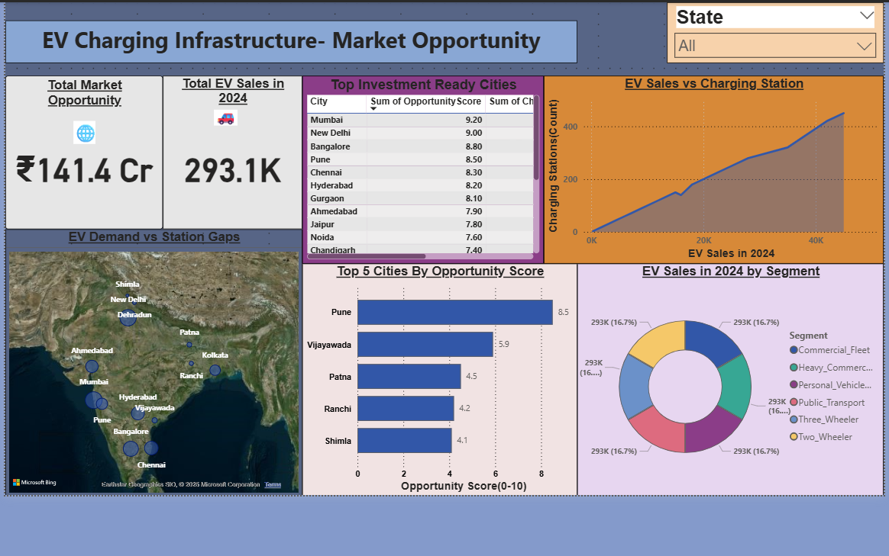
Market Opportunity
Total EV Sales (2024): 293K | Market Size: ₹141.4 Cr
EV Sales vs Charging Station capacity → infrastructure gap
Top investment-ready cities: Mumbai, Delhi, Bangalore, Pune, Chennai
Segments driving growth: 2W, 3W, commercial fleets, urban personal vehicles.

Slide 4
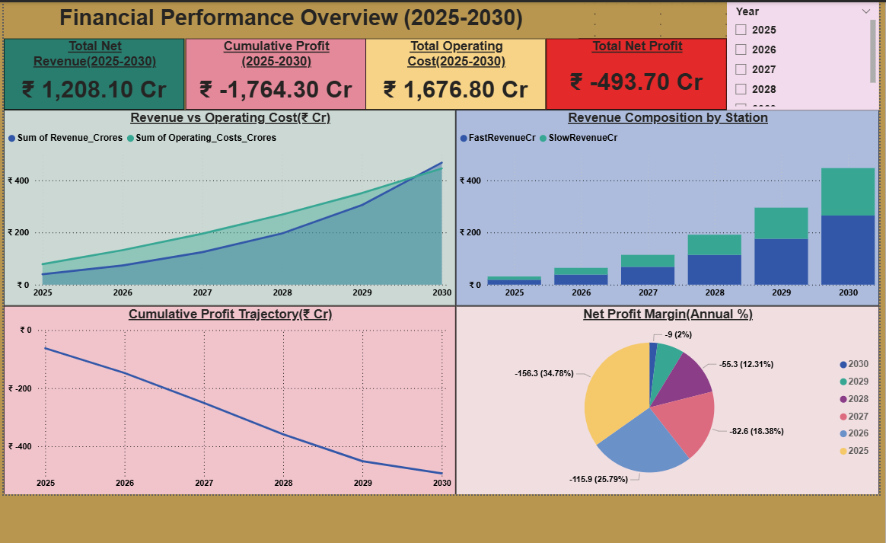
Financial Opportunity & Profitability
Revenue (2025–30): ₹1,208 Cr
Operating Cost (2025–30): ₹1,676 Cr
Net Profit (2025–30): –₹493 Cr (loss-making initially)
Profitability constrained by high capex & slow demand ramp-up
Long-term potential once utilization >75%

Slide 5
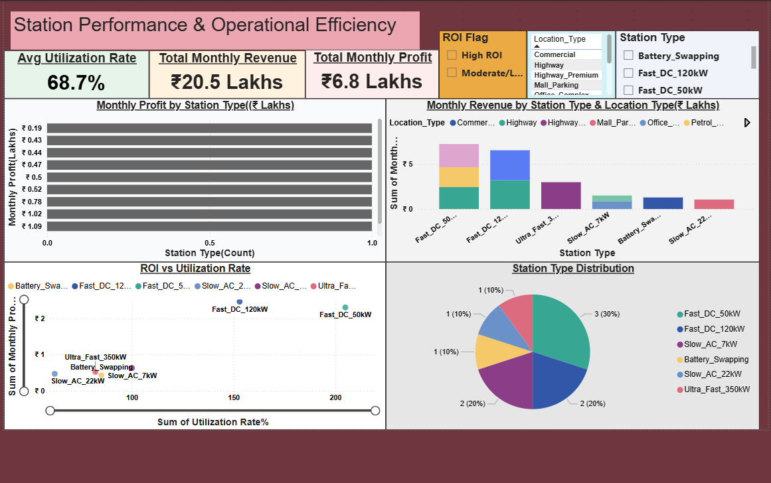
Station Performance and Operational Efficiency
Avg utilization: 68.7%
Monthly revenue: ₹20.5 Lakhs | Profit: ₹6.8 Lakhs
High ROI station types: Fast DC 50kW & 120kW
Low ROI station types: Slow AC & battery swapping
Commercial & highway locations deliver most consistent revenues.

Slide 6
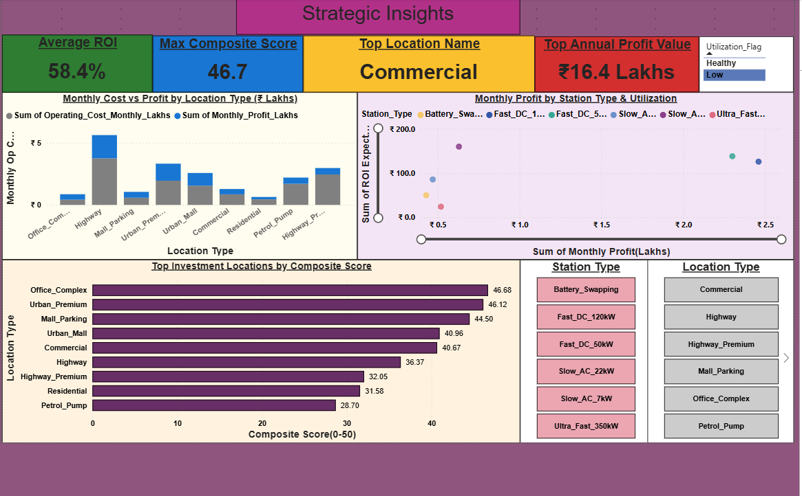
Strategic Insights
Avg ROI across stations: 58.4%
Top Location Types: Commercial complexes, Urban premium zones, Mall parking
Top Profit Value Location: Commercial (₹16.4 Lakhs annually)
Key Finding: ROI maximized by focusing on high-footfall, urban & commercial hubs.

Slide 7
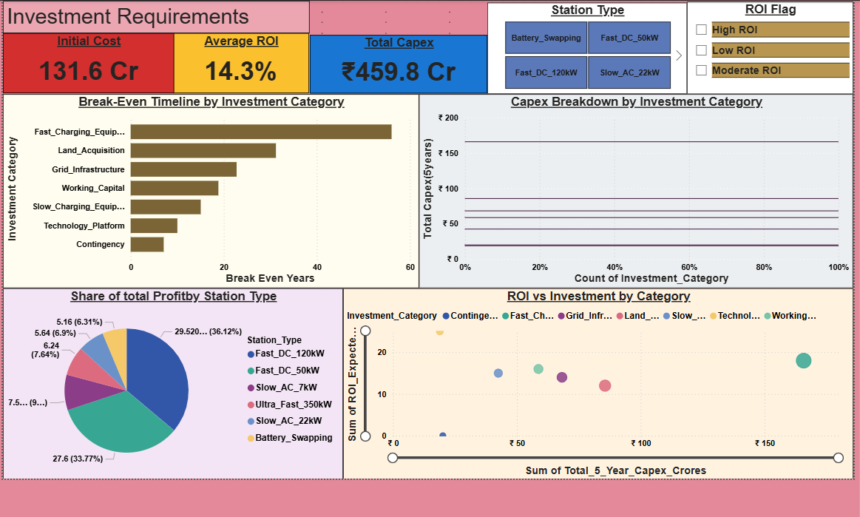
Investment Requirements
Initial Cost: ₹131.6 Cr | Total Capex (5 yrs): ₹459.8 Cr
Average ROI: 14.3%
Break-Even Timeline:
• Fast charging equipment → 50+ years
• Land & Grid infra → 20–40 years
Profitability concentration: Fast DC 50kW & 120kW → 70%+ of total profit
Slow AC & battery swapping → marginal returns

Slide 8
Recommendations for Client
Phased Rollout:
--Phase 1 (2025–27): Metro cities (Mumbai, Delhi, Pune, Bangalore)
-- Phase 2 (2028–30): Tier-2 cities + highways
Technology Mix:
-- Prioritize Fast DC chargers (50–120kW)
-- Limit Slow AC & battery swapping investments
Location Strategy:
-- Focus on Commercial, Urban Premium, Highways
-- Partnerships with malls, office complexes, petrol pumps
Financial Approach:
-- Leverage subsidies, PPPs, carbon credits
-- Optimize cost structure with shared infrastructure

Slide 9
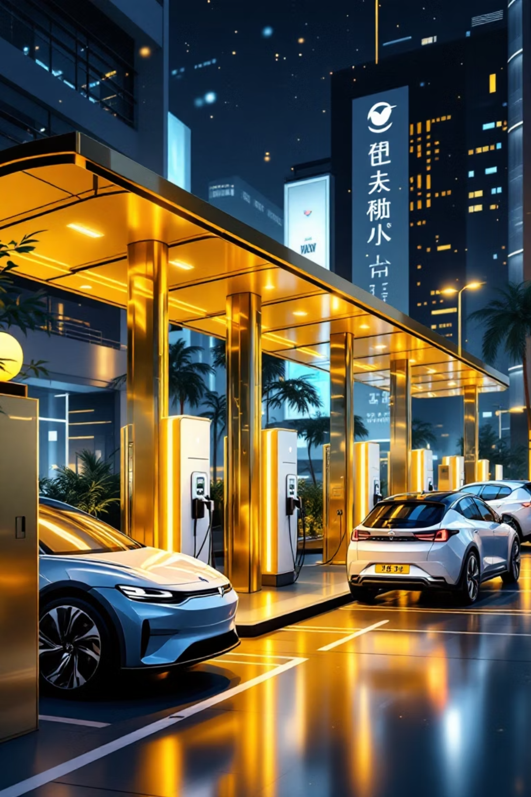
Conclusion
India’s EV market is large & fast-growing, but infra gap persists
Short-term: capital intensive & loss-making
Medium-long term: profitable with strategic rollout & right station types
Recommendation: Enter early with phased investment to capture first-mover advantage.

